Slide 1


Random CTLNs
Eric Han, Caitlin Lienkaemper

Slide 2
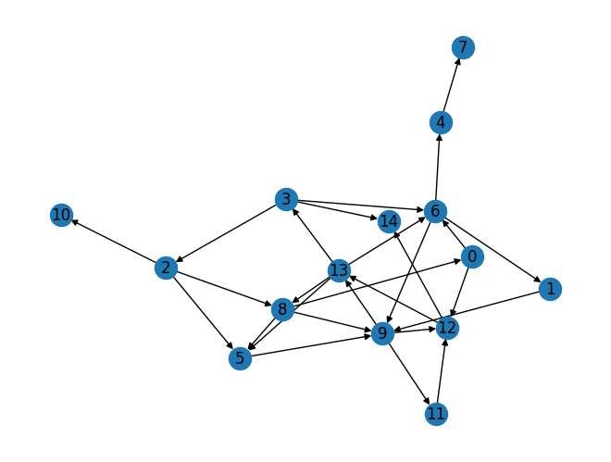
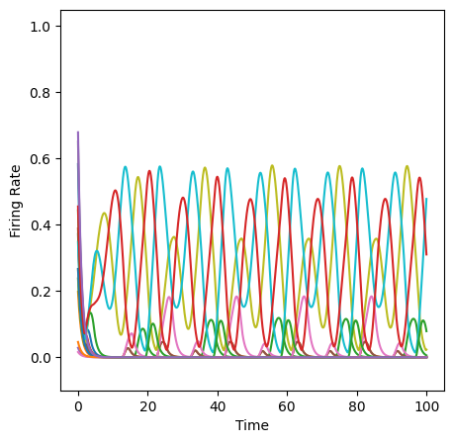
CTLNs, Broadly
Neurons, neuron populations have intricate connective patterns
How does connectivity shape dynamics?
A “sparsely connected” network of 15 neurons with connection probability 0.3, and no bidirectional edges. The firing rate dynamics coalesce to a limit cycle.
Notes:
We may focus specifically on the fine connectivity of neural networks as the main ingredient controlling dynamics. Emergent dynamics are nonlinear and coalesce to one of two stable states.

Slide 3
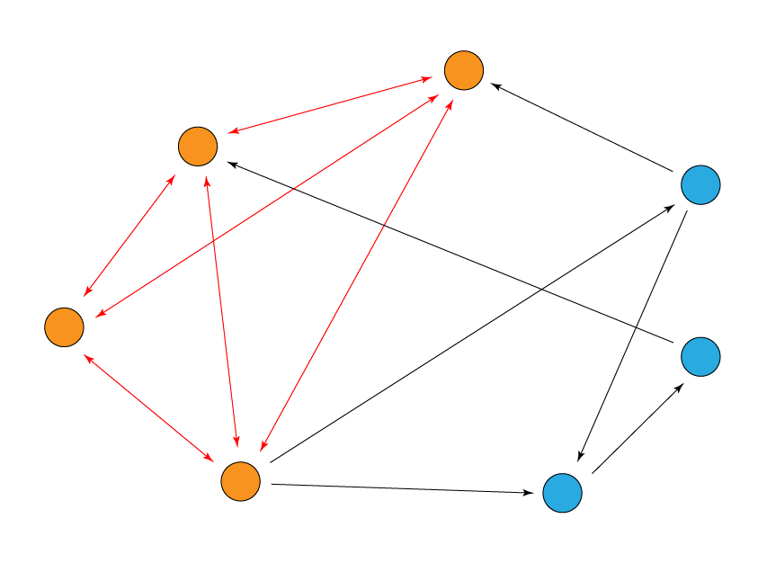
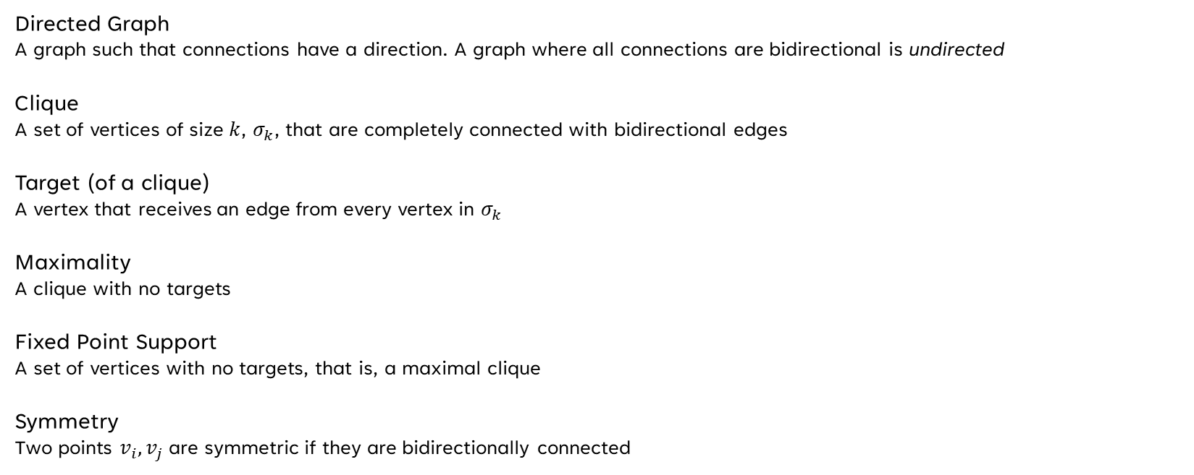
Important Definitions
Directed Graph
A graph such that connections have a direction. A graph where all connections are bidirectional is undirected
Clique
A set of vertices of size $k$, $σ_{k}$, that are completely connected with bidirectional edges
Target (of a clique)
A vertex that receives an edge from every vertex in $σ_{k}$
Maximality
A clique with no targets
Fixed Point Support
A set of vertices with no targets, that is, a maximal clique
Symmetry
Two points $v_{i}, v_{j}$ are symmetric if they are bidirectionally connected
A maximal 4-clique within a 7-graph. Notice that there is a 3-clique within the 4-clique, with the remaining excluded vertex being the target of the 3-clique

Slide 4
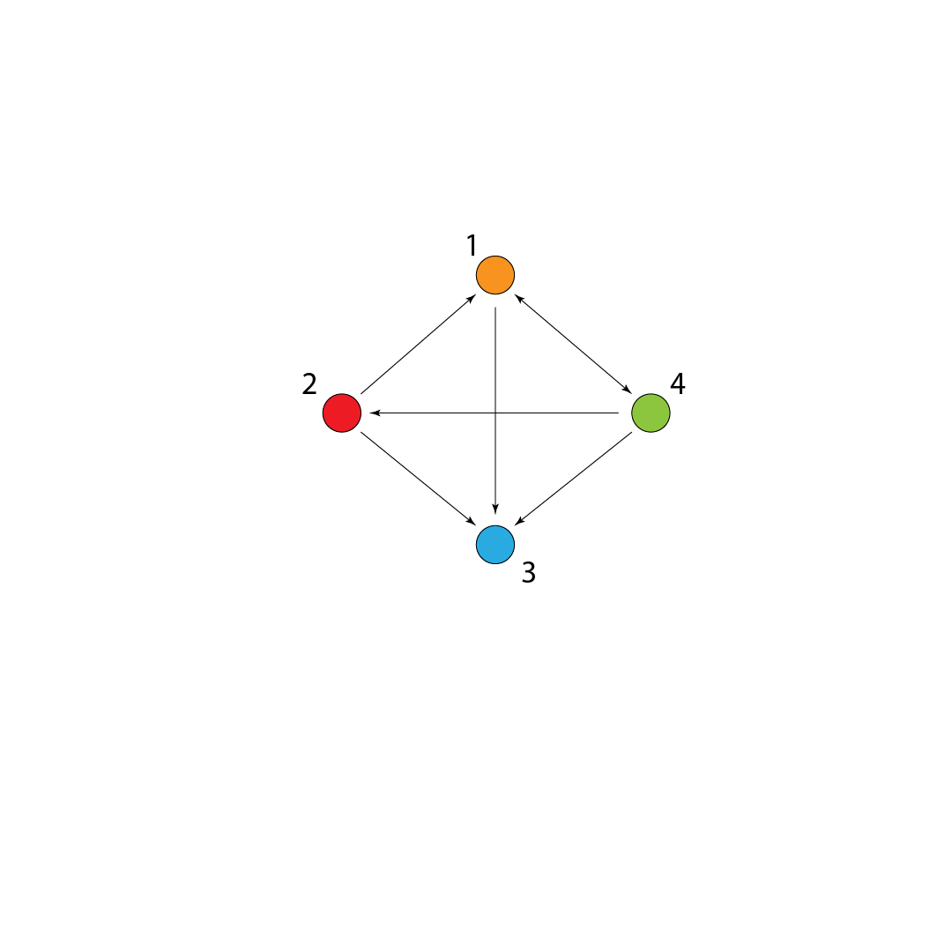
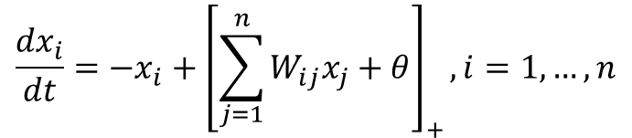
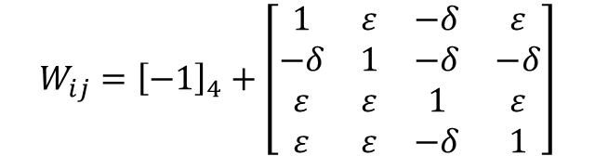
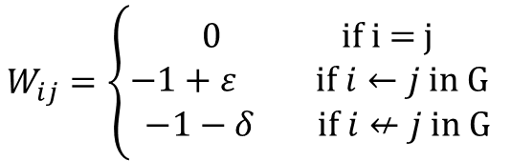
Governing Rules
Our governing equation…
$$W_{ij}={\left[−1\right]}_{4}+\left[\begin{matrix}1 & ε & −δ & ε \\ −δ & 1 & −δ & −δ \\ ε & ε & 1 & ε \\ ε & ε & −δ & 1\end{matrix}\right]$$
$$\frac{{dx}_{i}}{dt}=−x_{i}+{\left[\sum_{j=1}^{n}{W_{ij}x_{j}+θ}\right]}_{+}, i=1,…, n$$
is restricted to connection strengths
$$W_{ij}=\left\{\begin{aligned}0 \text{if} \text{i}\text{ = }\text{j} \\ −1+ε \text{if} i←j \text{in} \text{G} \\ −1−δ \text{if} i↚j \text{in} \text{G}\end{aligned}\right.$$
We fix $θ=1, ε=0.25, δ=0.5$ for our numerical model
Notes:
x_i represents the firing rate of the i-th neuron and theta is a constant external input. W_{ij} is a weight matrix that details the graph. The bracket represents a threshold that creates nonlinearity. We restrict the connection strengths because the CTLN model is supposed to model a network of n excitatory neurons whose net actions are inhibitory due to existing in an inhibitory field

Slide 5
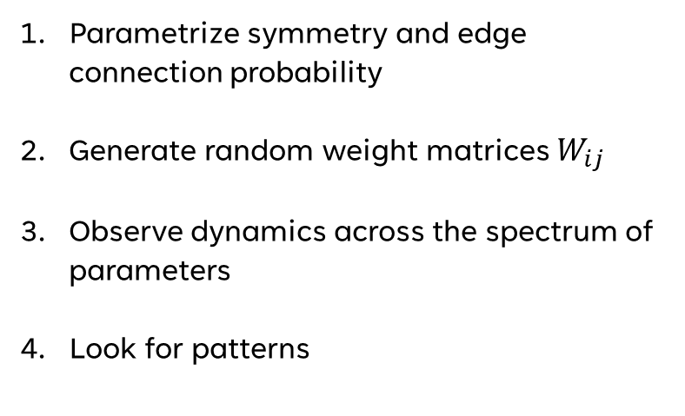
Randomness?
Parametrize symmetry and edge connection probability
Generate random weight matrices $W_{ij}$
Observe dynamics across the spectrum of parameters
Look for patterns

Slide 6
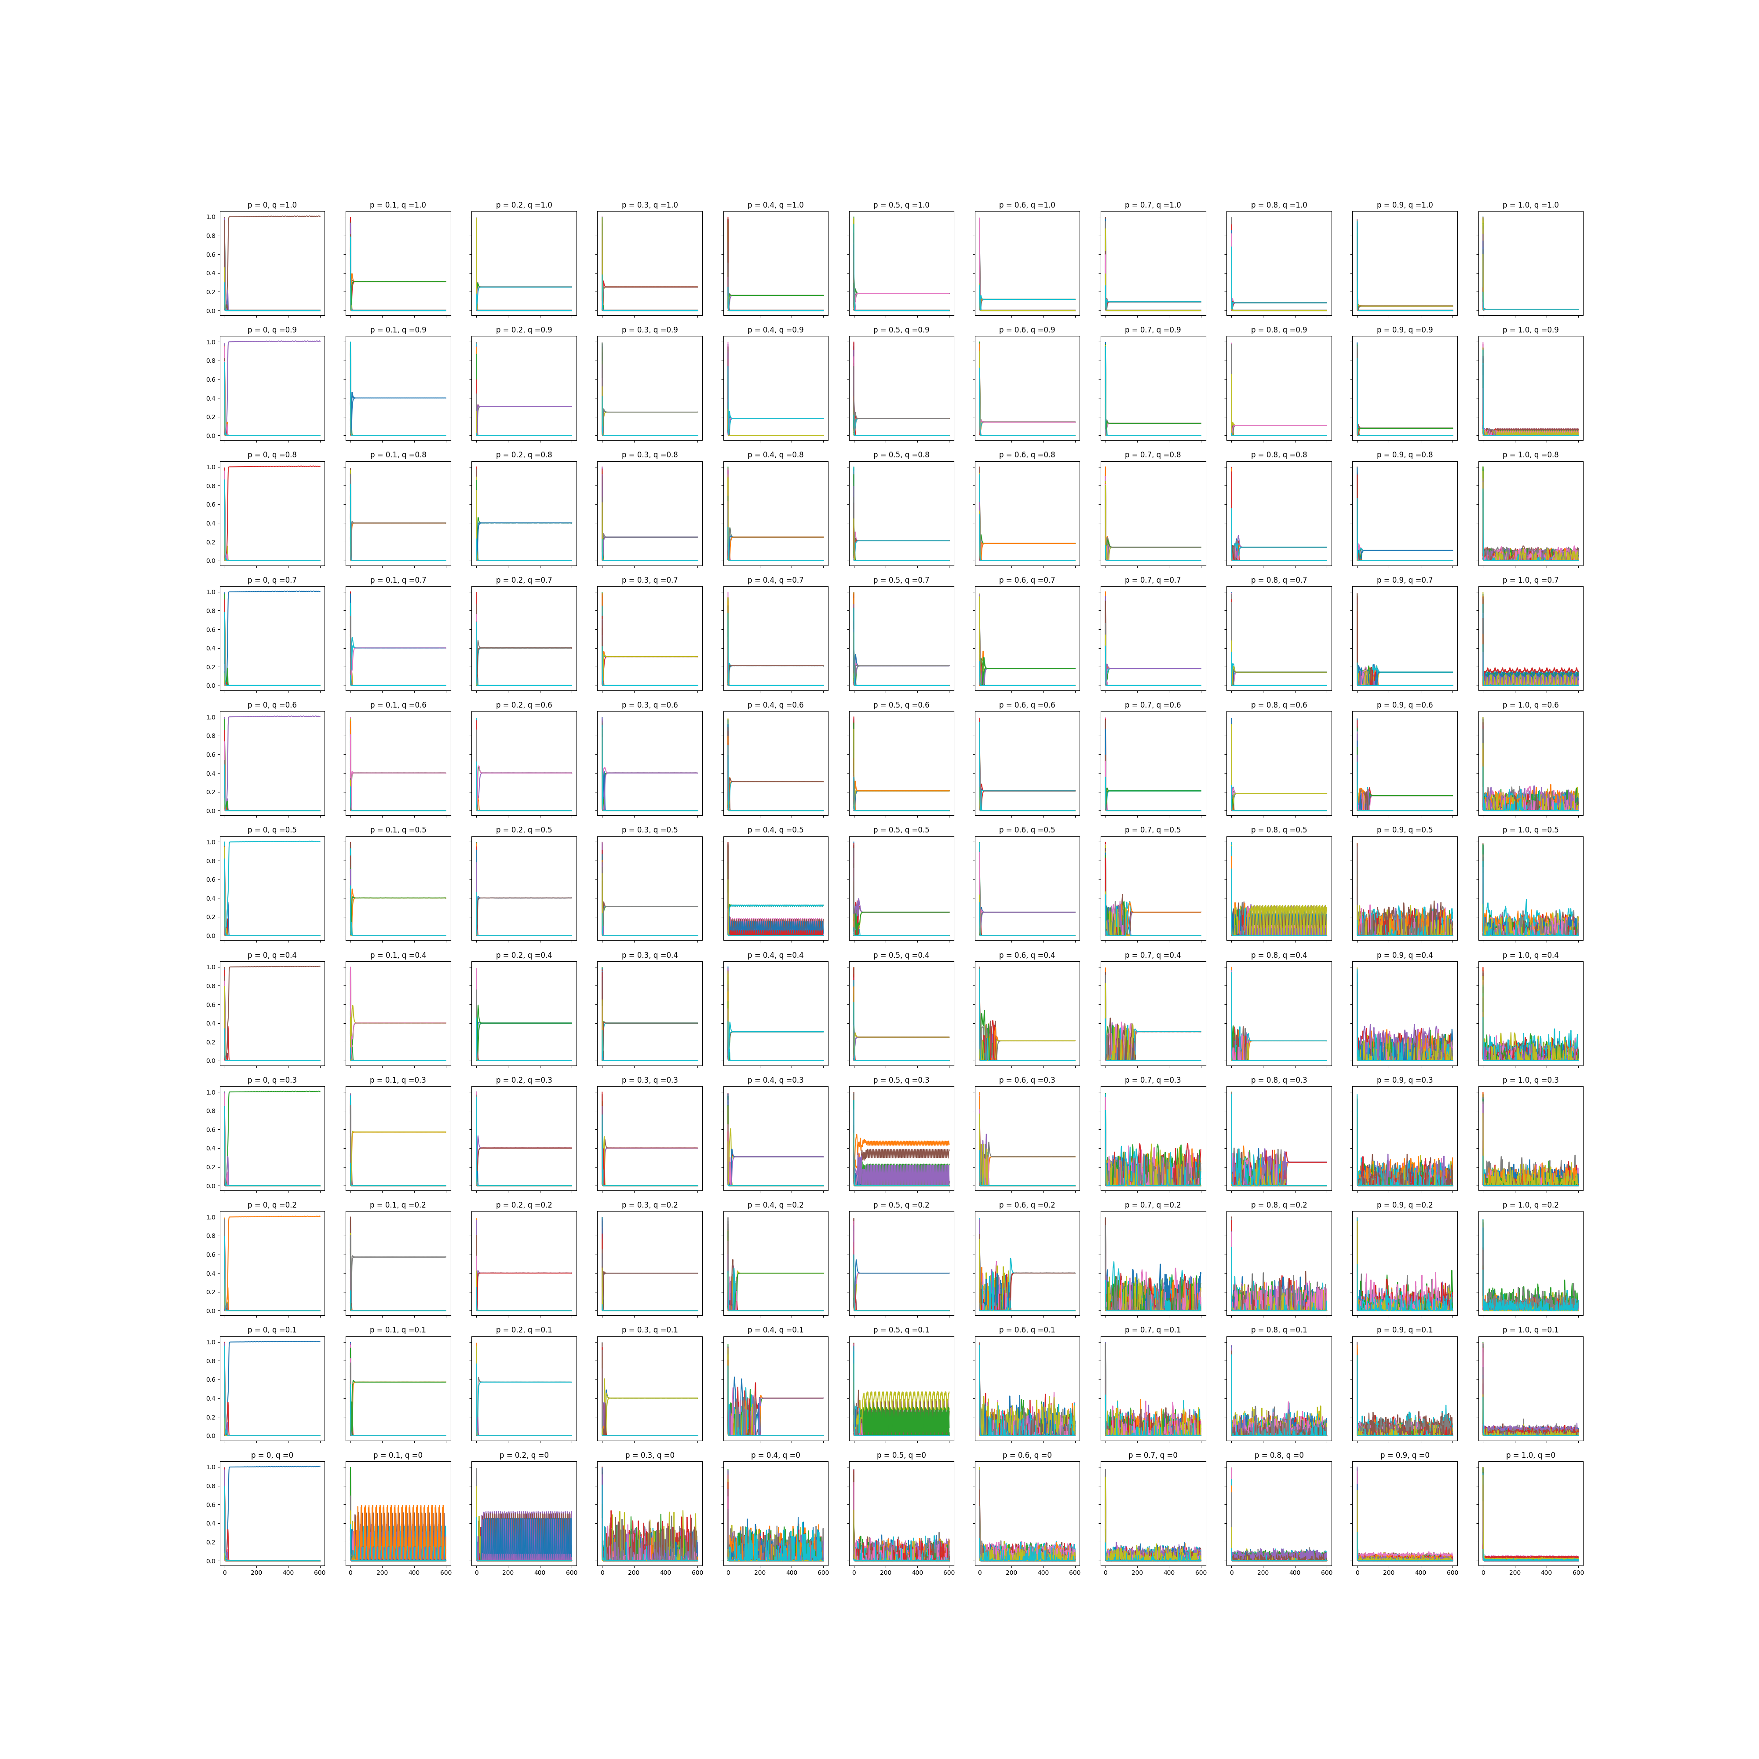
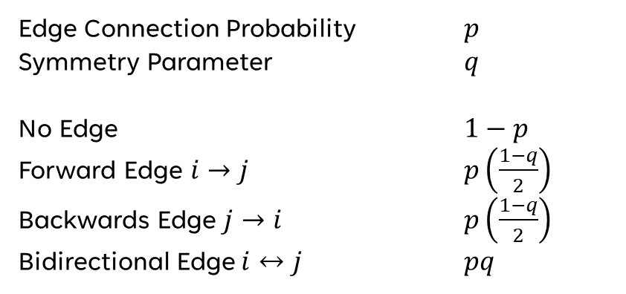
Edge Connection Probability $p$
Symmetry Parameter $q$
No Edge $1−p$
Forward Edge $i→j$ $p\left(\frac{1−q}{2}\right)$
Backwards Edge $j→i$ $p\left(\frac{1−q}{2}\right)$
Bidirectional Edge $i↔j$ $pq$

Slide 9
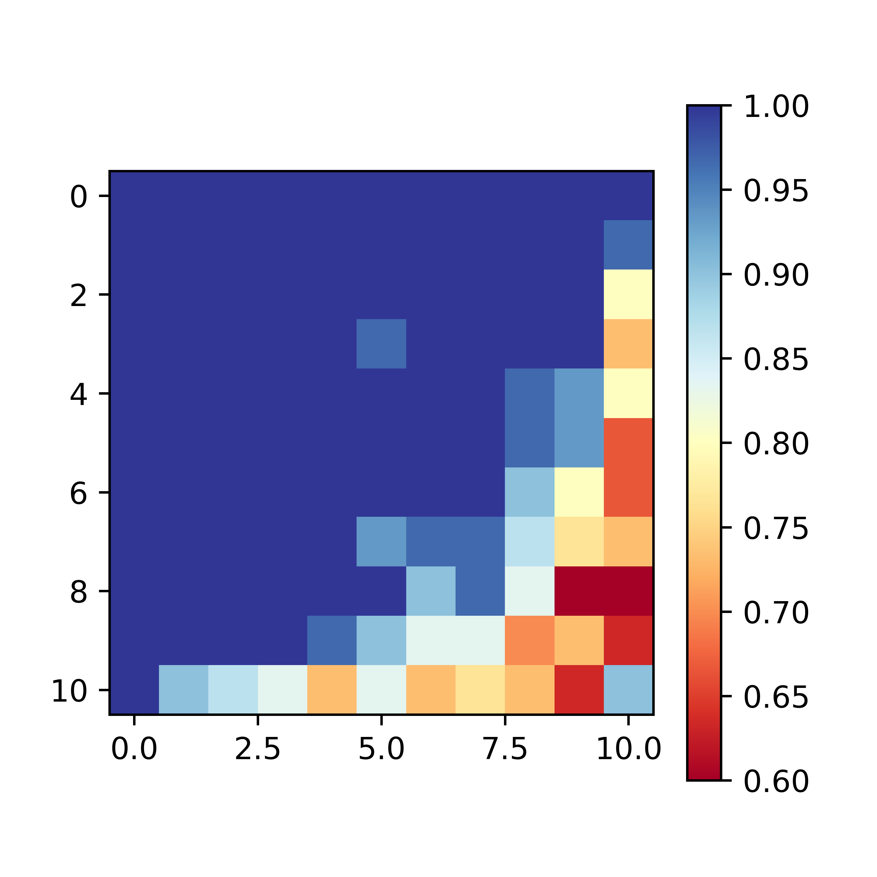
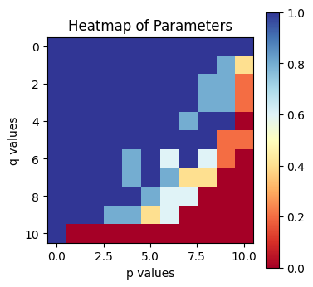
Major Progress!

Slide 10
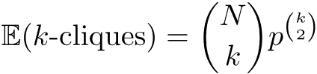
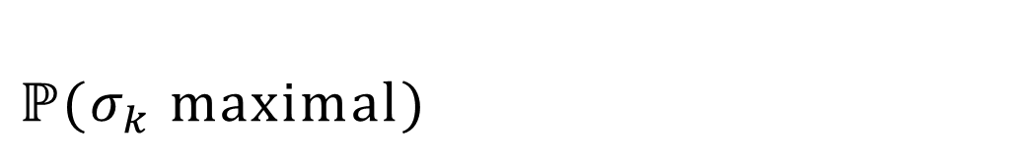
$$ℙ(σ_{k} \text{maximal})$$

Slide 11
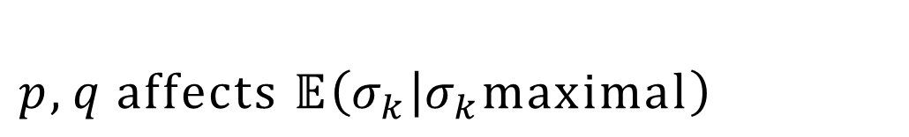
$$p,q \text{affects} \text{𝔼}\left(σ_{k} | σ_{k}\text{maximal}\right)$$
What does this mean?

Slide 12
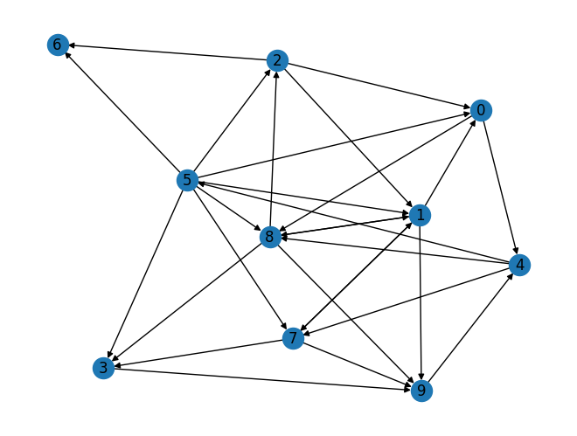
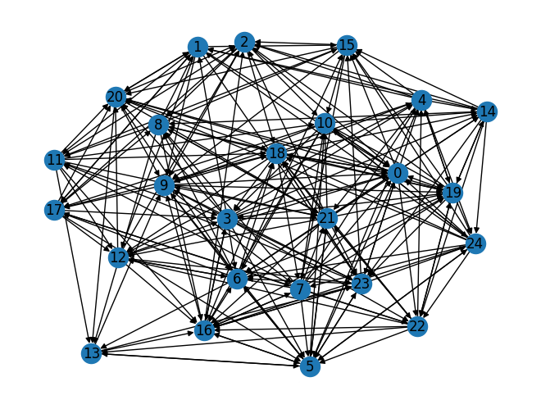
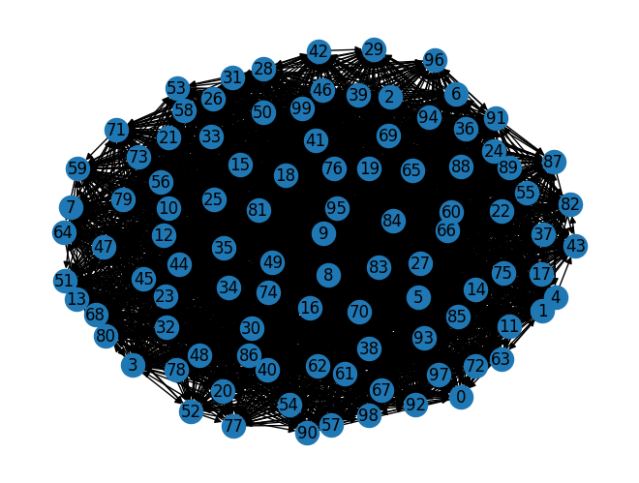
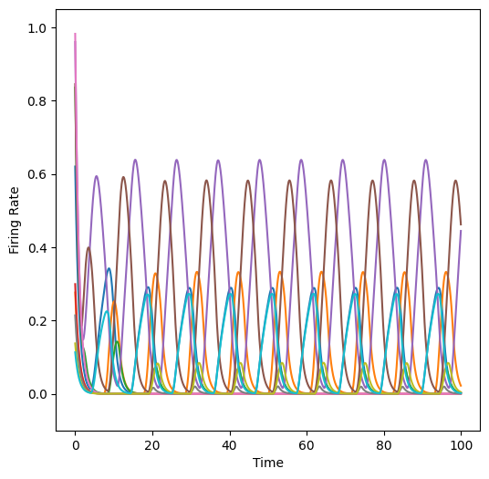
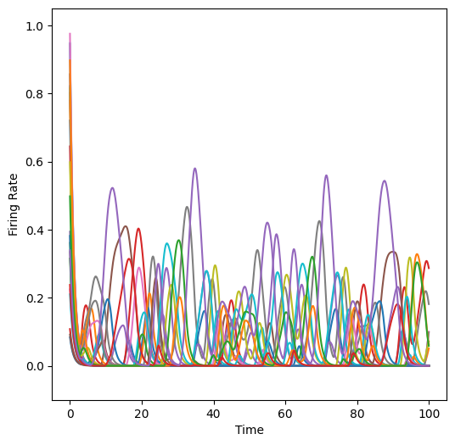
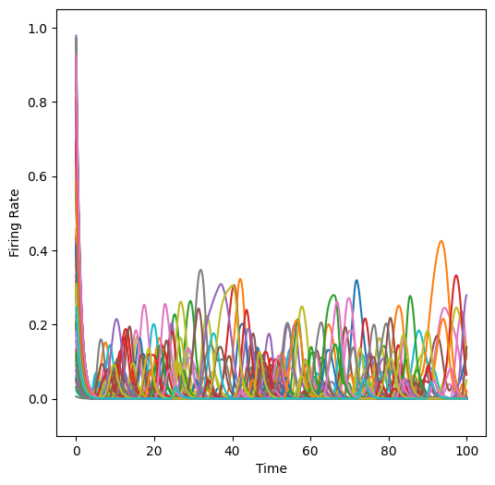
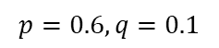
$$p,q \text{affects} \text{𝔼}\left(σ_{k} | σ_{k}\text{maximal}\right)$$
$$p=0.6, q=0.1$$

Slide 13
Bib
Parmelee, C., Moore, S., Morrison, K., & Curto, C. (2022). Core motifs predict dynamic attractors in combinatorial threshold-linear networks. PLOS ONE, 17(3), e0264456–e0264456. https://doi.org/10.1371/journal.pone.0264456
Parmelee, C., Alvarez, J. L., Curto, C., & Morrison, K. (2022). Sequence generation in inhibition- dominated neural networks. arXiv (Cornell University). https://doi.org/10.48550/arxiv.2212.08211

